Slide 1
Basic Electrical Technology [ELE 1051]
Chapter 3 - Resonance

Slide 2
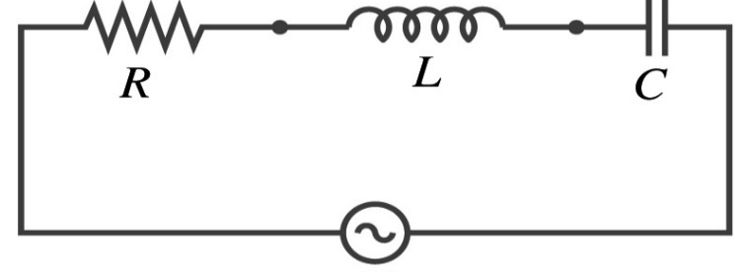

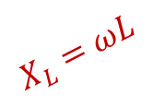

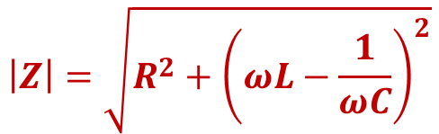
Series Resonance
R, X, Z
$$X_{L}=ωL$$
v(t), variable frequency
R
o
f
$$Z=R+j(X_{L}\sim X_{C})$$
f_{o}
$$X_{C}=−\frac{1}{ωC}$$
$$\left|Z\right|=\sqrt{R^{2}+{\left(ωL−\frac{1}{ωC}\right)}^{2}}$$
Z is capacitive
Z is inductive
$${′f}_{0} is called the resonant frequency′$$

Slide 3
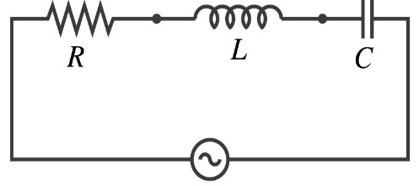





Series Resonance
When series RLC circuit is at resonance,
Current is in phase with voltage
Circuit power factor is unity
$X_{L}=X_{C}$
$Z=R$
Resonant frequency for a series RLC circuit is obtained as follows:
$$\text{Imaginary} \text{p}art of Z_{eq}=0$$
$$X_{L}=X_{C}$$
$$ω_{0}L=\frac{1}{ω_{0}C}$$
v(t), variable frequency
$$Z=R+j(X_{L}\sim X_{C})$$
$$f_{0}=\frac{1}{2π\sqrt{LC}} hertz$$

Slide 4









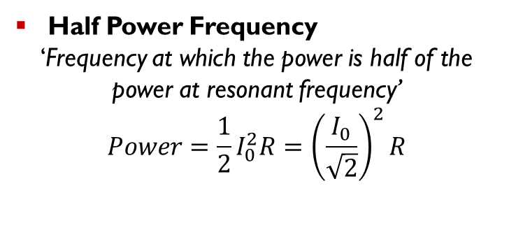



Current vs. Frequency in RLC Series Circuit
Variation of current with frequency
Half Power Frequency
‘Frequency at which the power is half of the power at resonant frequency’
$$Power=\frac{1}{2}I_{0}^{2}R={\left(\frac{I_{0}}{\sqrt{2}}\right)}^{2}R$$
$$i$$
$$I_{0}$$
$$\frac{I_{0}}{\sqrt{2}}$$
$$At ω_{1} and ω_{2}, I=\frac{I_{0}}{\sqrt{2}}$$
$$ω_{1}=Lower half power frequency$$
$$ω_{1}$$
$$ω_{0}$$
$$ω_{2}$$
$$ω$$
$$ω_{2}=Upper half power frequency$$
$$I_{0}=I_{max}=\frac{V_{rms}}{R}$$
$$Bandwidth=ω_{2}−ω_{1}$$
In practice the curve of $|I|$ against ω is not symmetrical about the resonant frequency

Slide 5





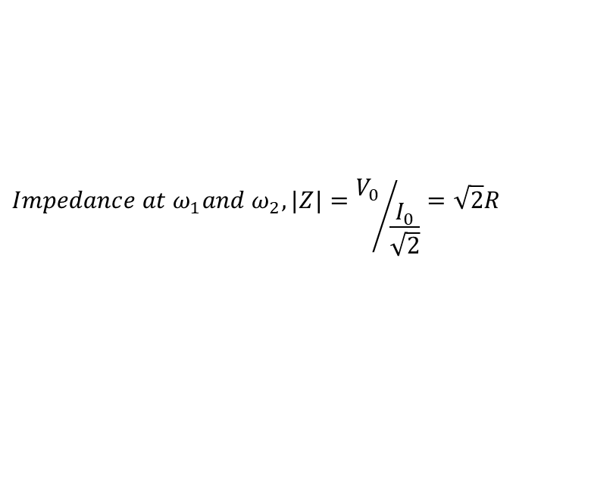






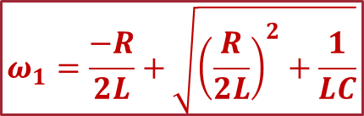
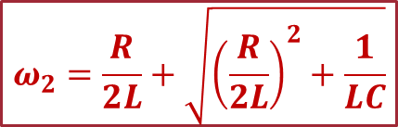
Half Power Frequency
$$Impedance at ω_{1}and ω_{2}, |Z|={V_{0}}/{\frac{I_{0}}{\sqrt{2}}}=\sqrt{2}R$$
$$\text{Below} \text{Resonant} \text{frequency}{ ω}_{0}, \left|X_{C}\right|>|X_{L}|$$
$$\text{Above} \text{Resonant} \text{frequency}{ ω}_{0}, \left|X_{L}\right|>|X_{C}|$$
At $ω_{1},$
At $ω_{2},$
$$\sqrt{R^{2}+{\left(X_{C}−X_{L}\right)}^{2}}=\sqrt{2}R$$
$$\sqrt{R^{2}+{\left(X_{L}−X_{C}\right)}^{2}}=\sqrt{2}R$$
$$X_{C}−X_{L}=R$$
$$X_{L}−X_{C}=R$$
$$\frac{1}{ω_{1}C}−ω_{1}L=R$$
$$ω_{2}L−\frac{1}{ω_{2}C}=R$$
$$ω_{1}=\frac{−R}{2L}+\sqrt{{\left(\frac{R}{2L}\right)}^{2}+\frac{1}{LC}}$$
$$ω_{2}=\frac{R}{2L}+\sqrt{{\left(\frac{R}{2L}\right)}^{2}+\frac{1}{LC}}$$
$$ω_{2}ω_{1}=\frac{1}{LC}=ω_{0}^{2}$$
$$ω_{2}−ω_{1}=\frac{R}{L}$$

Slide 6
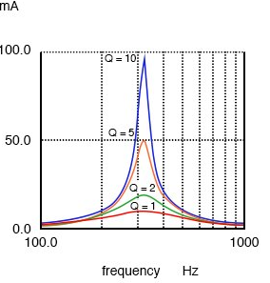
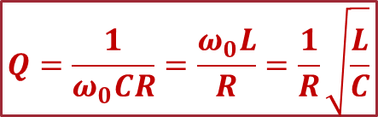
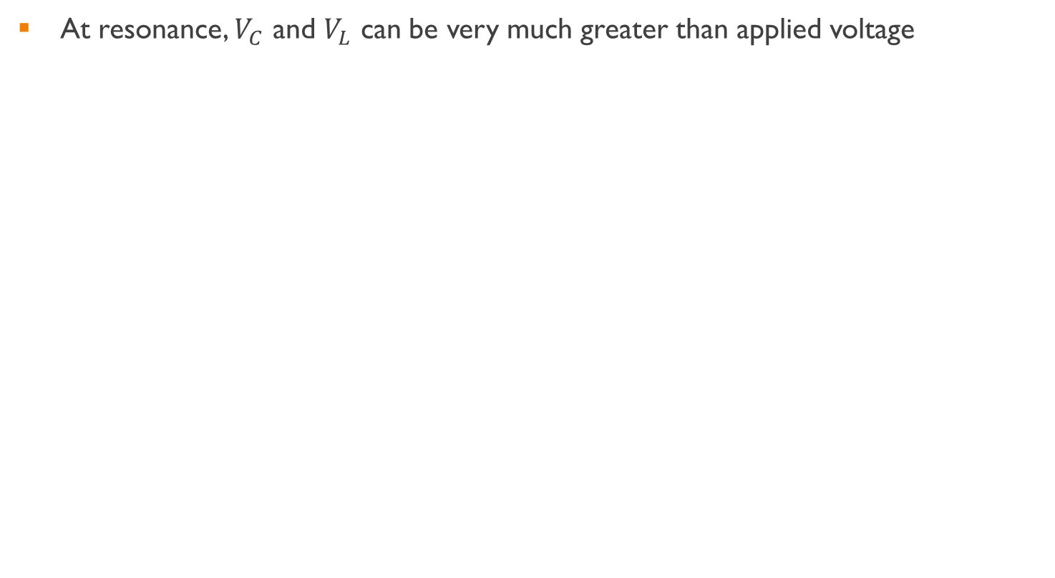



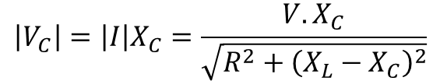

Quality Factor for series circuit
At resonance, $V_{C}$ and $V_{L}$ can be very much greater than applied voltage
$$\left|V_{C}\right|=\left|I\right|X_{C}=\frac{V.X_{C}}{\sqrt{R^{2}+{\left(X_{L}−X_{C}\right)}^{2}}}$$
$$Q=\frac{1}{ω_{0}CR}=\frac{ω_{0}L}{R}=\frac{1}{R}\sqrt{\frac{L}{C}}$$
At resonance, $X_{L}=X_{C}$
$$Q=\frac{Resonant frequency}{Bandwidth}$$
$$V_{C}=\frac{V}{R}X_{C}$$
$$V_{C}=\frac{V}{ω_{0}CR}=QV$$
Q is termed the Q factor or voltage magnification
High value of Q can lead to component damage
Careful design necessary
Larger the value of Q, more symmetrical the curve appears about the resonant frequency

Slide 7
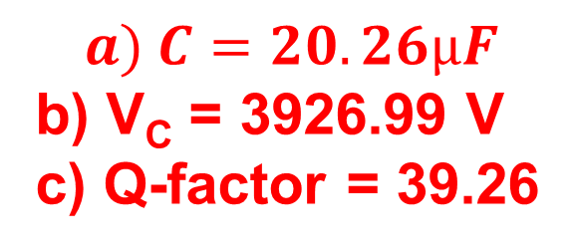
Illustration 1
A circuit having a resistance of 4Ω and inductance of 0.5H and a variable capacitance in series, is connected across a 100V, 50Hz supply. Calculate:
The capacitance to give resonance
The voltages across the inductor and the capacitor
The Q factor of the circuit
$$a) C=20.26μF$$
b) V_{C} = 3926.99 V
c) Q-factor = 39.26
Notes:
‘Huges Electrical & Electronic Technology’, 10th edition
Page No. 303, Example 14.1

Slide 8

Illustration 2
The bandwidth of a series resonant circuit is 500 Hz. If the resonant frequency is 6000 Hz, what is the value of Q? If R =10 Ω, what is the value of the inductive reactance at resonance? Calculate the inductance and capacitance of the circuit
$$C=0.22μF$$
Notes:
‘Huges Electrical & Electronic Technology’, 10th edition
Page No. 310, Example 14.3

Slide 9
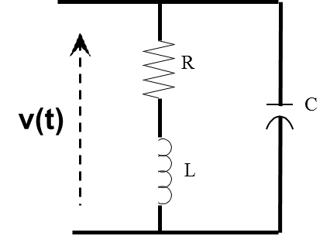
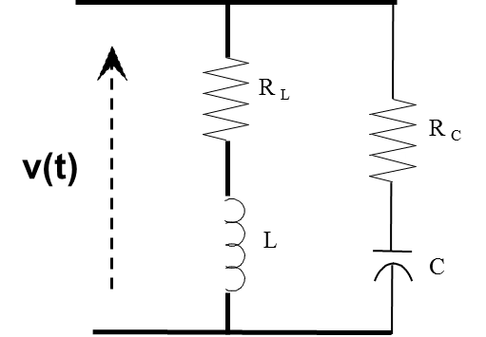
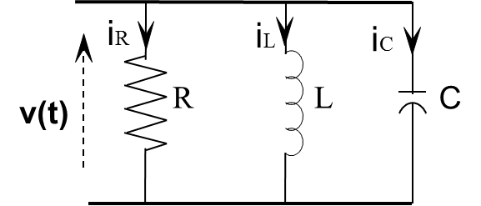
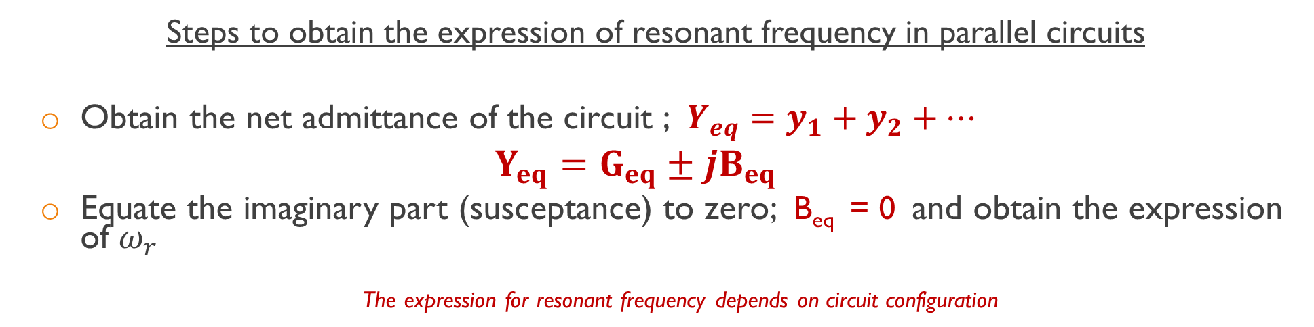
Resonance in parallel circuits
Steps to obtain the expression of resonant frequency in parallel circuits
Obtain the net admittance of the circuit ; $Y_{eq}=y_{1}+y_{2}+…$
$$Y_{eq}=G_{eq}±jB_{eq}$$
Equate the imaginary part (susceptance) to zero; B_{eq} = 0 and obtain the expression of $ω_{r}$
The expression for resonant frequency depends on circuit configuration

Slide 10


Current vs. Frequency in parallel Circuits
At resonance
Impedance is maximum
Resultant current minimum
$$I$$
o
ω_{r}
$$ω$$

Slide 11
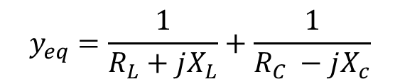
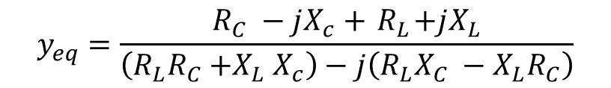
Parallel resonance circuits
$$y_{eq}=\frac{1}{R_{L}+jX_{L}}+\frac{1}{R_{C} −jX_{c}}$$
$$y_{eq}=\frac{R_{C} −jX_{c}+{ R}_{L}+jX_{L}}{\left(R_{L}R_{C}{+X}_{L}X_{c}\right)−j\left(R_{L}X_{C} −X_{L}R_{C}\right)}$$
Rationalizing ;
$$y_{eq}=\frac{\left(\left(R_{L}R_{C}{+X}_{L}X_{c}\right)+j\left(R_{L}X_{C} −X_{L}R_{C}\right)\right)\left(R_{C} −jX_{c}+{ R}_{L}+jX_{L}\right)}{{\left(R_{L}R_{C}{+X}_{L}X_{c}\right)}^{2}+{\left(R_{L}X_{C} −X_{L}R_{C}\right)}^{2}}$$
Separating the real & imaginary terms ;
$y_{eq}=$ $\frac{1}{{\left(R_{L}R_{C}{+X}_{L}X_{c}\right)}^{2}+{\left(R_{L}X_{C} −X_{L}R_{C}\right)}^{2}}\left(R_{L}^{2}R_{C}+R_{L}R_{C}^{2}−R_{L}X_{C}^{2}−X_{L}^{2}R_{C}\right)+j\left(R_{L}^{2}X_{C}+X_{C}X_{L}^{2}−X_{L}R_{C}^{2}−X_{C}^{2}X_{L}\right)$

Slide 12
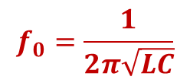
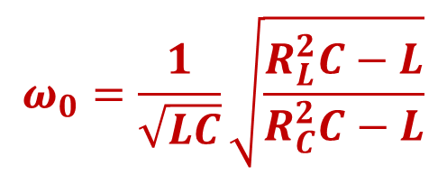
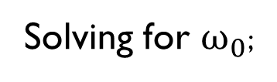
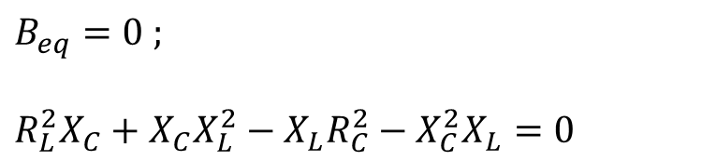
Parallel resonance circuits
Equating the imaginary part to zero;
$$B_{eq}=0 ;$$
$$R_{L}^{2}X_{C}+X_{C}X_{L}^{2}−X_{L}R_{C}^{2}−X_{C}^{2}X_{L}=0$$
Solving for $ω_{0}$;
$$ω_{0}=\frac{1}{\sqrt{LC}}\sqrt{\frac{R_{L}^{2}C−L}{R_{C}^{2}C−L}}$$
If R_{L} = R_{c} :
$$f_{0}=\frac{1}{2π\sqrt{LC}}$$

Slide 13
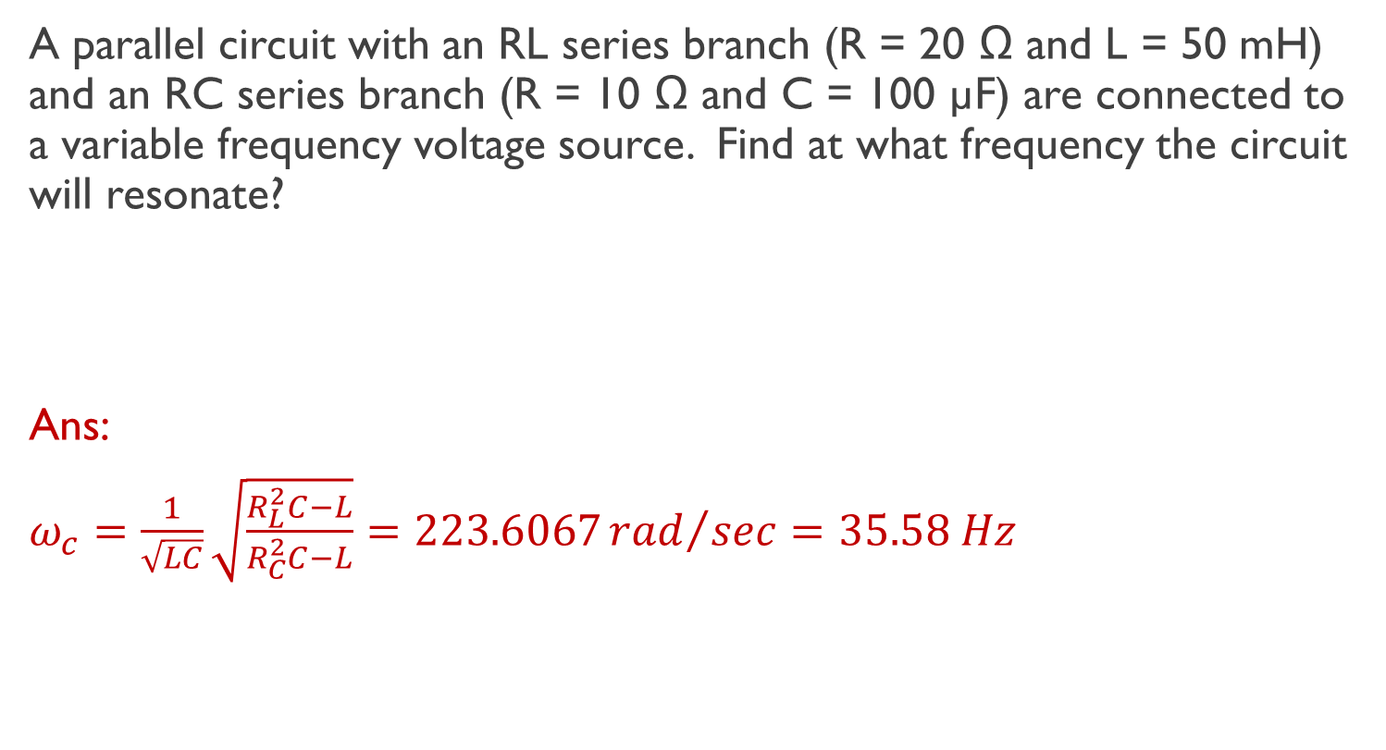
Exercise 1
A parallel circuit with an RL series branch (R = 20 Ω and L = 50 mH) and an RC series branch (R = 10 Ω and C = 100 µF) are connected to a variable frequency voltage source. Find at what frequency the circuit will resonate?
Ans:
$ω_{c}=\frac{1}{\sqrt{LC}}\sqrt{\frac{R_{L}^{2}C−L}{R_{C}^{2}C−L}}=223.6067{rad}/{sec}=35.58 Hz$
Notes:
Parker Smith’s 500 solutions of problems in electrical engineering – solved by V. C. Natesan
Page No. 186, Problem 6.69

Slide 14
Exercise 2
Obtain the expression for resonant frequency for the given parallel circuit

Slide 15

Thank You!

